Slide 1



BANK PERFORMANCE ANALYSIS

Slide 2


OUR TEAM (GROUP 6)
SINCHAL GAJBHIYE
KIRTI UPADHYAY TIWARI
SHRUTI SHETH
ARUN S
SURESH
POOJA VAHADANE

Slide 3
TABLE OF CONTENTS
01
02
03
04
All KPI ANALYSIS & RECOMMENDATIONS
WHAT WE LEARN
CHALLENGES
DASHBOARD SCREENSHOTS

Slide 4
01
ALL KPI ANALYSIS & RECOMMENDATION

Slide 5
Analysis of Loan Amounts Over Time (KPI 1)
2007
2008
2009
2010
2011
Analysis:
Most people earning less than 3 lakh per year seek loans for a variety of purposes, while those earning more than 3 lakh seek loans exclusively for debt consolidation and home improvements.
Percentage increase in loan amounts between consecutive years -
$12 M
(548.77 %)
$32 M
(222.79 %)
$75 M
(163.46 %)
$138 M
(113.13 %)
Though there is a substantial increase in loan amounts but growth rates have reduced yearly.
Recommendations:
People earning more than 3 lakh per year should be motivated to take loans for assets like cars, houses, small businesses, and other ventures by providing attractive offers and benefits.
The customers should have more time to repay a loan with longer loan terms.
The interest rate charged by the lender can impact the loan amount. A higher interest rate can increase monthly payments, which may affect the loan amount.

Slide 6
Analyzing Revolving Balance Distribution by Grade and Subgrade (KPI 2)
Analysis:
The total loan amount for Grade B is $161 M (30.35%), which is the highest among all grades.
Overall, the analysis of grade and subgrade wise loan amounts provides an understanding of the distribution of loan amounts across different risk level categories. Higher-grade customers tend to have higher loan amounts, while lower-grade customers have relatively lower loan amounts.
Recommendations:
Considering the salary bracket of less than 1 lakh, it is recommended to sanction a lower loan amount to Grade A, B, and C borrowers specifically for the purposes of debt consolidation and credit card management.
Bank should aim to diversify their loan portfolio across different grades and sub-grades. This strategy would help them to reduce risk by balancing higher-risk loans with lower-risk loans.
Educating customers about the loan process, credit management, and responsible borrowing practices can contribute to better loan performance.
Notes:
Based on our observations, we have noticed that individuals with salaries below 1 lakh in Grade A, B, and C categories tend to have higher revolving balances when taking out loans for debt consolidation and credit card usage.

Slide 7
Total Payment Breakdown: Verified vs. Non-Verified Status (KPI 3)
Analysis:
Most of the verification status is verified and source verified, but loan for the purpose of debt consolidation and credit card is not verified that’s why revolving balance is more in this category.
Credit Card
Others
NOT VERIFIED
Debt consolidation
Recommendations:
Strengthening the verification process by implementing stricter measures to verify the information provided by borrowers, such as income verification, employment checks, and identification verification. This can help ensure that borrowers' financial information is accurate and reliable.
Bank may consider verified customers as lower risk due to the verification process and higher loan amounts. However, it's important to conduct ongoing monitoring to ensure the continued financial stability of these customers.
Notes:
To enhance the verification process, it is recommended to implement more rigorous measures to validate the information provided by borrowers. This can include conducting thorough income verification, employment checks, and identity verification procedures. Strengthening these verification measures will help ensure the accuracy and reliability of borrowers' financial information.

Slide 8
Loan Status Breakdown: State-wise and Month-wise Analysis (KPI 4)
Analysis:
We have understood that California (CA) has the highest number of loans (7,099), followed by New York (NY) with 3,812 loans and Texas (TX) with 2,727 loans. This indicates that these states have a relatively higher demand for loans.
Recommendations:
By identifying states with high loan demand and modifying marketing strategies accordingly.
Bank can consider focusing their efforts on states with low loan counts to expand their customer base and increase their lending activities.
Try to Recover Loan Amount from CA & NY state having annual income Less than 3 Lakh.

Slide 9
Statistical Overview of Home Ownership (KPI 5)
Analysis
As per the analysis, mortgage has the highest loan count, i.e. significant number of customers who have mortgages on their properties.
Rent is the second most common home ownership status, indicating a large number of customers who are renting their homes.
Recommendations
Collaborate with real estate agents, property managers, or landlords to establish referral programs. This can help reach potential customers within the real estate industry.

Slide 10
02
WHAT WE LEARN?

Slide 11
WHAT WE LEARN?
Importance of key performance indicators in data analytics.
Parameters to be assessed after loan distribution by banks e.g. home ownership, revolving balance, grades, verification status, etc.
How all these parameters are extracted from data to make Pivot tables, charts and beautify interactive and mesmerizing dashboards in Excel, PowerBI and Tableau using slicers, filters, icons and images. Writing queries for the same in SQL.

Slide 12
03
CHALLENGES

Slide 13
CHALLENGES DURING PROJECT
True challenge was to assemble our classroom knowledge and to put it into this real-world situation.
Different opinions and priorities to be gathered as a team for each tasks.
Compiling and selecting the best outcomes for presentation.

Slide 14
04
DASHBOARD SCREENSHOT

Slide 15
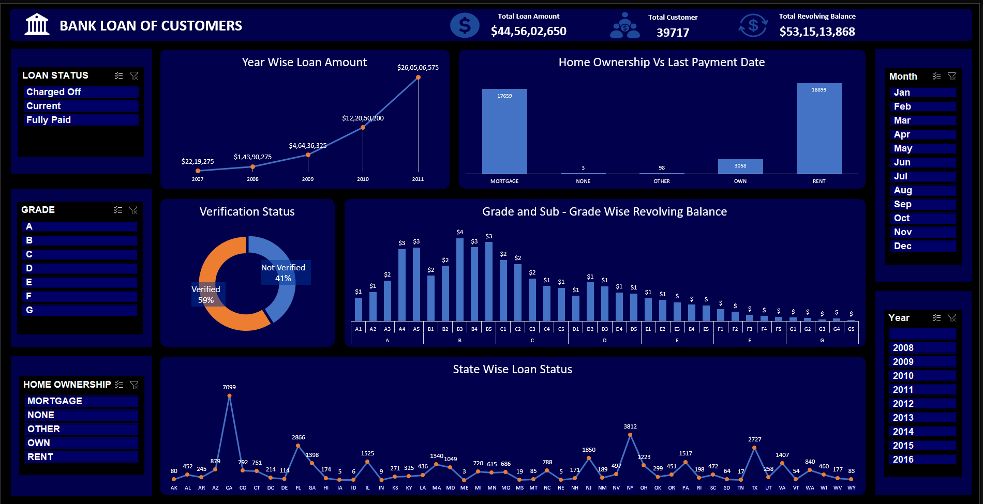
Excel Dashboard

Slide 16
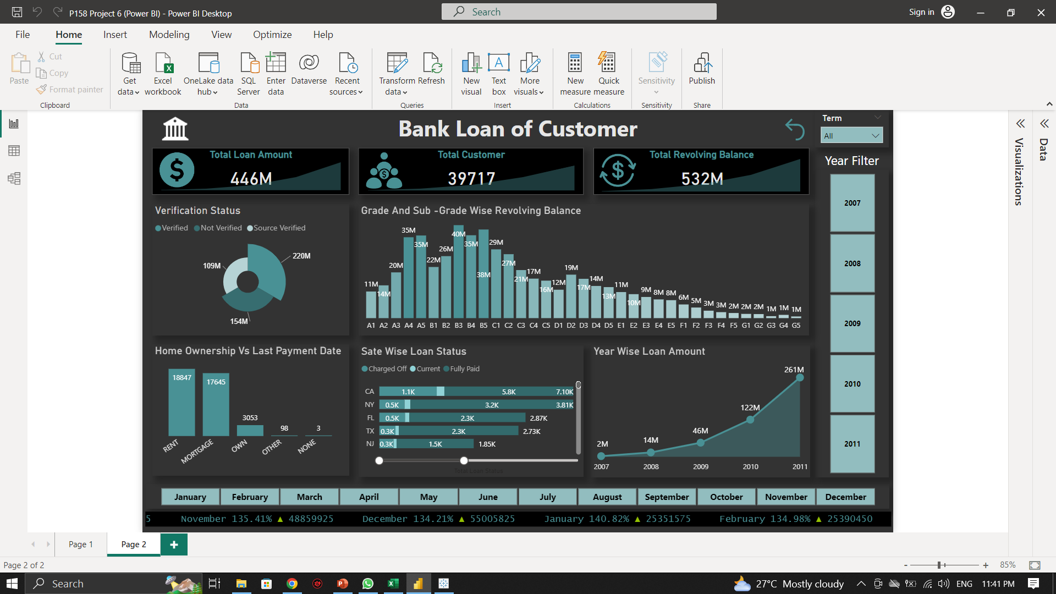
PowerBI Dashboard
PowerBI Dashboard

Slide 17
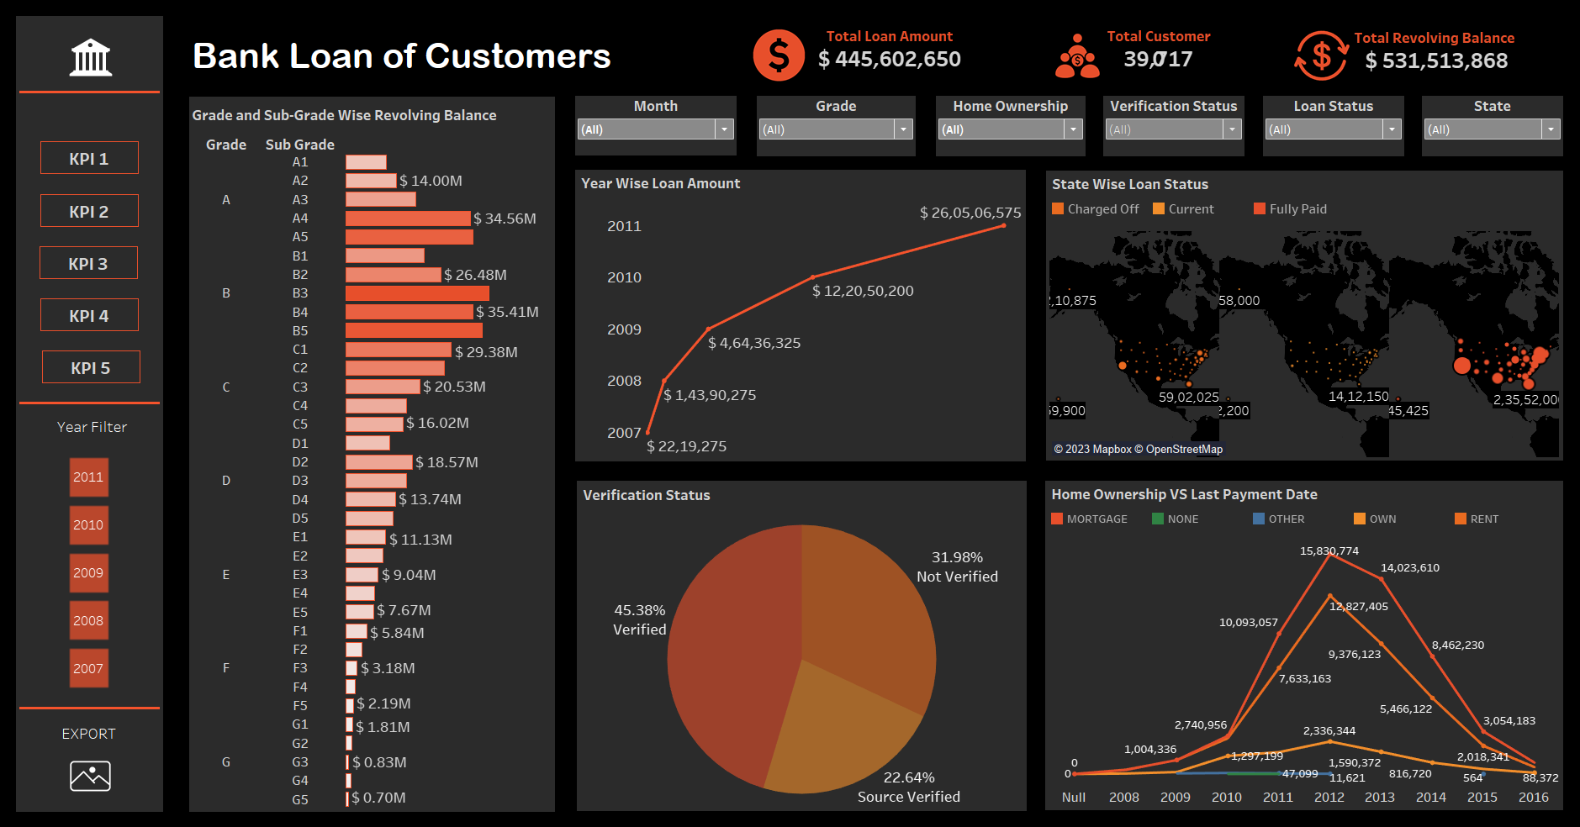
Tableau Dashboard

Slide 18



THANKS
YOU!
Do you have any questions?

